Slide 1
Family Values and World Peace in the 21st Century Universal Peace Federation
Notes:
Presentation by Lynn Walsh at a UPF conference in Prague, Czech Republic, October 2014 . This slide show is very long. The presentation can be edited, shortened, added to, done in sections, etc. to fit your purpose and audience.

Slide 2
Primary Threats to Peace
Poverty
Inequality
Extremism
Tribalism
Terrorism
Imperialism
Violation of human rights
Emotional, physical and sexual abuse
Failing states
Global disorder
Corruption
The inability to value and treat others as ourselves
Notes:
There are numerous threats to peace today. But we can say that underneath each of these factors there is a lack in the ability to value and treat others as oneself. In other words the heart of the human problem is in the human heart.

Slide 3
“Since wars begin in the minds of men, it is in the minds of men that the defenses of peace must be constructed”
Preamble to the Constitution of UNESCO
The family, the fundamental and natural unit of society, is where the minds and hearts of every human being are formed.
Notes:
This quote is often repeated at the UN. We know that the heart and mind of each individual is formed by their relationships in their family.

Slide 4
Is Family Relevant to Peace?
Why do all religions emphasize family life?
Why did Marxism insist on abolishing the traditional family?
Are demographics and fertility rates relevant to national security and GDP?
Is literacy and education of women relevant to social development and peace?
Does it matter how we parent, educate and raise children in the home?
Notes:
IN asking these questions we see that the family is relevant to many levels of world peace.

Slide 5
Marginalization of the Family
Little mention of the family in:
Millennium Development Goals
Discussion of Sustainable Development Goals
Analyses of poverty
Analyses of extremism
Analyses of tribalism and ethnocentrism
Discussion of the empowerment of women
Notes:
And yet we see often missing or limited inclusion of the role of the family in social policy. At the UN, in trying to solve the major world problems, there is no mention of the family in the MDGs (Millennium Development Goals), now the newly created SDGs (Sustainable Development Goals).

Slide 6
Marginalization of the Family
Greater emphasis on:
Sexual activity without reference to the family
Protecting and empowering non-traditional sexual practices
Rejection of a bi-polar view of gender, gender roles what is best for children
Experimenting with new sexual and child-rearing approaches
Redefining love, sex, marriage and human potential
Notes:
Instead of emphasizing the family as part of solving world problems, we hear more deconstruction of the family and confusion over sex, gender and parenting. More and more it seems love is only understood as a feelings, sex as only a physical impulses of which we have a right to satisfy regardless of consequences and marriage as defined by feelings of love as long as the feelings last. Human potential seems to be, at best, fluctuating emotions upon which we are compelled to act. Is this true? Are human potential and relationships developed best when based on self-centered whims and impulses?

Slide 7
What is Our Purpose and Potential?
Notes:
How did we come to this point? Here is an analogy. If we do not know the purpose or potential of something, we may not use it to its potential or worse, damage or destroy it. What would happen if we used a laptop as a water filter? In the same way, don't we need to understand the purpose of human life? What can be our greatest achievements on our time on earth? If we do not ask this we could be misusing and even destroying the potential of humankind and drifting from our moral, relational and spiritual capacities?

Slide 8
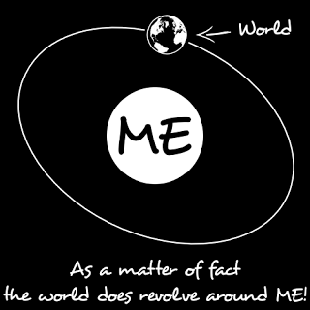
Which Best Help Us Fulfill Our Potential and Happiness and Contribute to World Peace?
Values centered on the individual?
Values centered on the family?
Notes:
Today we see self-centered purpose and individualism increasing and family-centered values decreasing. (Give examples if necessary.) And yet like cells in a body that want to be independent of the rest of the body, how well does society function when citizens are only their own well-being?

Slide 9
Self-Centered Values
Shape our identity based on emotions, pleasure seeking, sexual feelings.
Diminish development of genuine self-worth.
Destroy healthy, joyful relationships.
Prevent us from contributing positively to others and society.
Self-centeredness is dead ended.
Notes:
Living for our own sake, guided by our moment to moment feelings and pleasure seeking, severely limits our ability to relate to others, and our self worth. Living a self-centered life we cannot contribute to society and cannot truly be happy. Our culture is lying to our youth as it encourages selfishness because self-centeredness is dead ended.

Slide 10
Two People Relating without a Higher Purpose Create a Self-centered Relationship.
Notes:
How well does a relationship work between two people focused on their self?
What happens? (ask them) What is missing?

Slide 11
Higher Purpose Elevates Us
Higher Purpose
Better results
Notes:
Acknowledgment of a higher and shared purpose in a relationship makes all the difference. When we identify with a higher purpose, we are drawn out of selfishness and invest more of our self and in doing so we grow.

Slide 12
Humans Are Relational, Fulfilled through Loving and Being Loved.
Higher Purpose
Better result
Notes:
All humans came into being because of the relationship of their mother and father. We survive, develop and thrive only through relationships. The more sense of higher purpose shared in those relationships the more likely the relationship will be stable, loving and fulfilling.
Human beings are fundamentally relational. We are born from one relationship of our mother and father. We can survive only by depending on the willingness and ability of parents to sacrifice for us. And can only thrive as human beings when we are love and when we are loving of others, Fulfillment does not come without giving of our self, even being vulnerable. We are relational and are fulfilled in loving relationships. We all crave being known, accepted and loved but we also grow the most when we learn to act out of the well-being of others.

Slide 13
What Is the Most Important Decision We Make in Our Life?
Notes:
So it is fair to ask, “What is my purpose in life? What higher purposes can I serve in my life?”
It is good to ask young people, “What is the most important decision you make in your life?” . Often the reply is, “what school I attend, my career, where I live.” Sometimes someone says, “who I will marry.” But when you think about it …

Slide 14
Who Will Be the Mother or Father of My Children?
Notes:
The most important decision is who will be the mother or father of my children? Why?

Slide 15
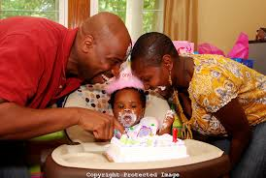
Our Parents’ DNA and Social-Emotional Health Predict Much of Who We Are
Notes:
Many youth don’t get it until you remind them that the DNA of their mother and father largely determined their intelligence, their looks, , eye color, body shape and size, talents, gifts, health, etc. Then what about the impact of the relationship between one’s parents? Whether it be non-existent, stable and loving or charged with violence, we are imprinted with early lessons about relationships, what is a man , what is a woman, from our early experiences with those most important to us our parents.

Slide 16
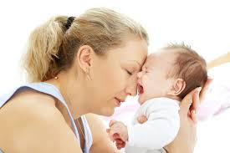
We Need Stability, Dedicated Care, Love and Guidance to Learn Consequences, Acquire Morals and Develop a Conscience.
Notes:
In order to develop to our optimum potential, we each require dedicated care and love as well as years of guidance to learn consequences, respect of others and to develop morals and a strong conscience. No parents are perfect but the stability and maturity of our parents predict the advantages or disadvantages we will receive.

Slide 17
We Need Stable, Secure Attachment and Sense of Belonging to Thrive and Grow.
Notes:
Studies have shown that as relational beings secure attachment from the very beginning and through all stages of maturing, enhances our greatest human abilities. Secure attachment predicts emotional makeup, the ability to trust and learn and the development of a healthy sense of self and thriving relationships throughout life. Without sense of genuine love and belonging we try to fill the need with more destructive attachments.
Adolescents seek attachment & learn who they are as individuals through their relationships. Without close relationship with parents, teens will instead attach to peers who naturally lack maturity, often do not give good guidance nor think about their long term well-being. Teens lacking good relationships with their parents naturally seek attachment with peers, and this is when we see teens constantly on the texting or on phone, desperate to leave the family dinner table to be with friends. Many of us parents have thought this was normal and therefore healthy but peers do not give good guidance nor long-term caring commitment. We know teens are easily misled by their peers. Only mature committed parents give the secure bond and principled guidance adolescents need to develop their potential.

Slide 18
Authoritative Parents Teach Peacebuilding through Their Relationships.
The unconditional love, consequences and morals characteristic of authoritative parenting build genuine relationship skills and instill values.
Permissive and authoritarian parenting do not produce these results.
.
Notes:
Ideally we learn how to relate genuinely through genuine relationship with our parents. Authoritative parents provide unconditional love and understanding so children feel truly known and accepted as we all need. But Authoritative parents also as authorities teach consequences by giving consequences, teach self-discipline by giving logical discipline, and teach moral and values to guide ones conscience. Permissive parents who give in to feelings cannot provide this. And authoritarian parents that give orders and harsh rules with out understanding the world of the child also cannot teach the child genuine relationships of love and principle. (We really need to and can help parents learn to parent effectively. )

Slide 19
Benefits to Children of Married Parents
More likely to attend college
Physically and emotionally healthier
Less likely to be physically or sexually abused
Less likely to use drugs or alcohol and to commit delinquent behaviors
Decreased risk of divorcing when they get married
Less likely to become pregnant/impregnate someone as a teenager
Less likely to be raised in poverty.
("Why Marriage Matters: 26 Conclusions from the Social Sciences," Bradford Wilcox, Institute for American Values, www.americanvalues.org/html/r-wmm.html)
Notes:
Over and over again studies confirm married mothers and fathers give children the greatest benefit. Read… Again this does not mean that single or divorced parents cannot do an excellent job. We know they can and many do so heroically but it is clearly more difficult and that makes it statistically less likely in general. It is not the ideal. If we do not know the ideal, just as if we do not know the goal, how will be ever improve as human beings, and reach our goal and potential.

Slide 20
Marriage: More than a Piece of Paper
Marriage provides the best environment for secure attachment and learning how to love, with emotional and sexual exclusivity, fidelity and lifetime commitment.
Marriage challenges us to learn to love our opposite.
Marriage elevates the sexual union to its profound procreative potential and bonding of masculinity and femininity for life, lineage, continuation of humankind.
Notes:
Marriage provides the best environment for raising children. And adults also thrive with a stable sense of belonging, exclusivity and commitment that marriage is meant to encourage. read Marriage has a clear purpose.

Slide 21
Marriage Is Far More Than a Piece of Paper.
Marriage creates stability in the community as men (and women) commit to restrain their sexual behavior for only their spouse.
There is less male-to-male violence growing out of competition and distrust.
Decrease in testosterone, decreases aggression.
There is less domestic violence when husband and wife trust each other.
Notes:
Marriage also creates stability within communities as married men commit to regulate their sex drive (women too) and commit their fidelity toward their spouse. This leads to decrease in male to male violence as the competition for mating declines and creates more trust between spouses. Data clearly indicates that marriage reduces domestic violence, and increases trust and emotional security. Also we know biologically male testosterone, and therefore aggression, is reduced through marriage and in relating directly with their children. (Studies of violent criminals in prison when allowed to relate to their children experience a reduction of testosterone.)

Slide 22
Marriage Bonds the Father to the Mother and Child, Protecting their Attachment.
Notes:
Imagine what is in the mind of this young man who just experienced the most significant moment in his life, the birth of his first child. How prepared is he to take on this pivotal moment? It will make all the difference in the whole future of his little daughter, and in the future of the mother. Will he at that moment in full commitment, dedicate himself to cherish and give his all to his wife as a husband and baby girl as her father ? Will he step up to be a true man?

Slide 23
Children Benefit from Having Both a Father and Mother.
”The best psychological, sociological and biological research to date suggests that on average men and women bring different gifts to the parenting enterprise, that children benefit from having parents with distinct parenting styles, and that family breakdown poses a serious threat to children and to the societies in which they live.”
(Brad Wilcox, Ph.D., Univ. of Virginia, in Reconcilable Differences)
Notes:
Studies show that children benefit from the different parenting qualities given by their mother and their father. Read

Slide 24
Gender Differences in Brain Activity Female brains are 15% more active and more interactive than male brains. Female Male
Notes:
Males and females have far more in common than differences. Socialization is a large factor in some differences we observe. But also there are some clear biological differences. As shown in this slide the female brain is more active and more areas of the brain work simultaneously compared to the male brains. This difference plus hormonal, anatomical and reproductive differences all impact differences in behavior, communication and thought process. These factors are at play in different parenting tendencies of mothers and fathers. (sources: Gorski, Simon Barron-Cohen, Louanne Brizendine, Buss, Dabbs, Coates, Klaver, Brad Wilcox, etc.)

Slide 25
Different Parenting Tendencies
Mothers teach emotional intelligence, social connection, empathy, communication.
Mothers see the world in terms of the child: Is he safe?
Fathers teach consequences, social order, principles, rules, goals.
Fathers see the child in terms of the world: Will he succeed?
Notes:
Yes, there are many exceptions. No male or female has all the general tendencies. However, there seem to be different proclivities of how mothers and fathers relate and what they teach their children. Read

Slide 26
Loving Marriages Model the Complementarity and Equity of Genders to their Children and the World.
Notes:
How do we bring gender equality, the kind that is sustainable? Loving marriages of mutual respecting husband and wife model and teach their children and the world the positive team work and complementarities of males and females. Men and women are of equal value, and yet are not the same. Marriage models the kind of balance of different masculine and feminine gifts and capacities that will enable our society to function at its highest capacity. The loving marriage of husband and wife models what the world needs to emulate.

Slide 27
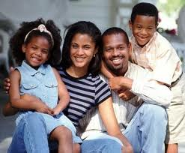
Children Learn from Their Parents’ Relationship the Value of Sexual Relationship Only within Marriage.
Notes:
Children learn from their parent’s sexual fidelity the value of saving sex until marriage and practicing faithfulness within marriage. They will see that sex within marriage is the most liberated, meaningful and expresses the deepest love and purpose in life. Youth who value abstinence before marriage, are less distracted by romantic relationships and can invest in developing their integrity, knowledge and skills to better ensure success and happiness in adulthood.

Slide 28
Unity of Masculinity/Femininity Is Reflected in the Universe and Embodied in Marriage.
Notes:
We see the universal complementarities of feminine and masculine throughout nature and science. Think of the proton and the electron, and the stamen and the pistil. Also we see all major religions recognize marriage as expressing a divine gender complementarity and expression of God’s love.

Slide 29
All Major Religions Recognize Marriage as Sacred and Fundamental for Familial and Societal Stability.
Notes:
All major religions recognize marriage as sacred and fundamental purpose for living on the earth. Religious thought prompts us to connect to a higher self within and instills us with moral guides for the betterment of others, best expressed in marital and familial love, sacrifice and joy.

Slide 30
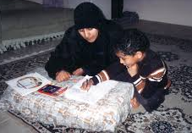
Humans Seek a Higher Purpose, Metaphysical Meaning of Life, and a Spiritual Connection to the Universe.
Notes:
Not only are humans fundamentally relational but we are fundamentally spiritual. We want to be useful and have a cause. We seek meaning in life by understanding of our higher purpose and ask metaphysical questions. This human desire elevates us to live for a higher purpose than ourselves. The stable family is the natural environment to begin exploring morals and metaphysical issues and develop faith in their higher purpose.

Slide 31
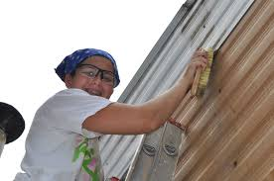
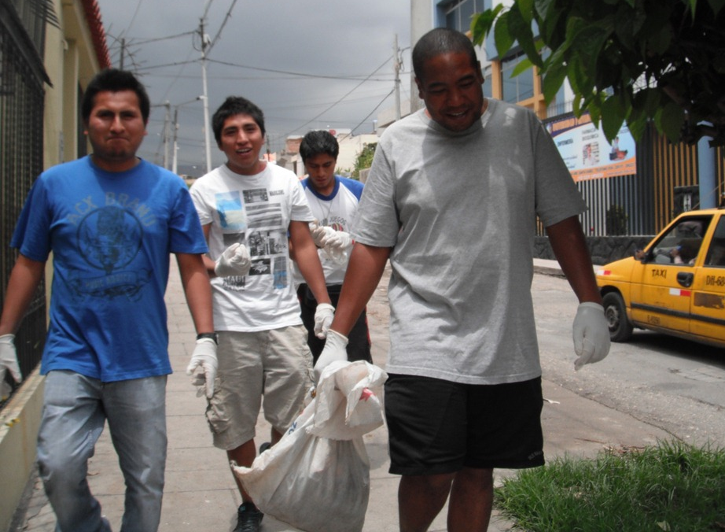
Recognizing a Higher Purpose and Living for Others: Essential for Peace building.
“Only in true surrender to the interest of all can we reach that strength, that unity of purpose, that equity of judgment which are necessary to measure up to our duty to the future.”
(Former UN Secretary-General Dag Hammarskjold)
Notes:
With a greater sense that we are one global family, connected to each other’s well-being, our living for others comes naturally and we grow as a human being. With a sense of meaning and purpose our identity is shaped. Serving others becomes a way of expressing one’s identity and purpose. Learning to serve and care about others and develop good friendships is excellent preparation for marriage and family life.

Slide 32
The Natural Order of the Family
Provides each member secure belonging and protection
Gives everyone a purpose for life in loving others.
Forms a natural social hierarchy.
Stimulates intergenerational love, respect and filial piety.
Notes:
The family provides the foundation for social order. Read

Slide 33
The Natural Order in the Family
Vertical order
Grand- parents
Individual
order
Parents
Brother
Sister
Brother
Sister
Children
Horizontal order
Notes:
An individual without a higher purpose than the self has no centering axis and can easily become centered on fluctuating feelings and self-defined purpose, often spinning into a self-destructive orbit. The family aligns each member to a higher purpose, the well-being of each other connected through their lineage. The vertical connection through generations up and down makes clear one’s responsibiliy and binding love and respect for each other. Through integenerational relations values, moral, ethics and traditions can be passed down. In our horizontal heartistic connection of empathy and love we are aligned with social responsibilities to and genuine valuing of self and others. Both the vertical and horizontal relationships within a family enables chidlren to receive love, acceptance and attachment along with guidance, priniciples and morals. Both aspects combined are necessary within a loving relationship. Also in the family we learn to respect on a horizontal level our sibling, having to share and learn that not all things are supposed to be equal or “fair” . We also learn in our relationships with our parents and grand parents vertical respect and appreciation, that our elders life experience are assets that protect us and help us mature. Within the natural social order of the family hierarchy, children learn the importance of social order and respect hierarchy because the family hierarchy is based and exists, not for power, control or oppression but through genuine and loving relationships.
Our loving relationship with our parents can also be an important foundation for our personal relationship with God. In the family we learn a natural social order and hierarchy, that is based on loving concern for ones well-being.

Slide 34
Heavy Costs of Not Understanding the Value and Purpose of Family
Notes:
Now I will look at the costs of not valuing marriage and the family
(Depending on time, this can be skipped, or gone through very quickly)

Slide 35
Unmarried Mothers Are Increasing
Notes:
Although many single parents do a wonderful job, deserving recognition and support, but they are the first to say it is far more challenging raising children alone. Most single-mothers did not wish that their children not have a loving and responsible father to help raise their children in a stable home. And we know what children want: a loving mom and dad. Nevertheless, single parenting is rising around the world.

Slide 36
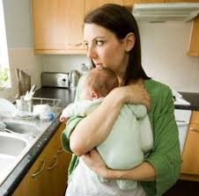
Single Parenting Increases Poverty Risk.
In Europe children growing up with a single parent are particularly at risk: 34.5% of single-parent households are at risk of poverty.
(Eurostat 2011 figures code ilc_li03)

Slide 38
Cohabitation Is Less Stable Than Marriage.
Around 3 million children in the UK have experienced the separation of their parents. This is partly attributable to a rise in cohabitation, given the increased likelihood of break-up for cohabiting couples relative to married couples. (Institute for Fiscal Studies, Cohabitation, Marriage Stability, 2010)
27% of couples who were cohabiting when their child was born separated by the time the child is age 5, compared with 9% of couples who were married when their child was born. (H. Benson, UK, 2009)
Notes:
Cohabitation though increasing provides far less stability to children and adults with the breakup rate being almost twice or with this data three times as likely than for married couples.

Slide 39
Divorce Is Increasing Worldwide
Notes:
Data indicate the increasing trend of divorce around the world.

Slide 40
Children in the UK Who Grew up Fatherless
Eight times more likely to go to prison.
Five times more likely to commit suicide.
20 times more likely to have behavioral problems.
20 times more likely to become rapists.
32 times more likely to become runaways.
10 times more likely to abuse chemical substances.
Nine times more likely to drop out of high school.
One-tenth as likely to get A's in school.
(The Institute for the Study of Civil Society [Civitas] U.K.)
Notes:
Read

Slide 41
Main Risk Factors for Youth Violence
Low level of attachment between parents & children
Poor supervision of children by parents
Harsh physical punishment to discipline children
Parental conflict when children are young
Mother who had her first child at an early age
Parental separation or divorce which children are young
Low level of family cohesion
Low socioeconomic status of the family (World Health Organization Report)
Notes:
According to WHO, the main cause of youth anger and violence is poor connection to parents. As we are primarily relational, it is not surprising that family instability has a toll on the emotional health and behavior of youth.

Slide 42
Crisis in Mental Health in Youth
In the midst of unprecedented material affluence, US children experience deteriorating mental and behavioral health such as rising rates of depression, anxiety, attention deficit, conduct disorders, thoughts of suicide, and other serious mental, emotional, and behavioral problems.
(Commission for Children at Risk, a panel of 33 leading children’s doctors, neuroscientists, research scholars, and youth service professionals)
Notes:
Read and summarize. So it seems it is not material well-being that is the main factor for the demise of mental health of young people.

Slide 43
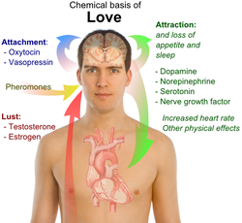
Sexualization of the Media Portray Men as Sex Driven and Women as Sex Objects
Notes:
The message of self-centered values leave men defined as sexual animals. Women are led to believe being sexually desired will give them the love they really want. Neither males or females are fulfilled in this sexualized perspective. Both are inhibited from fulfilling a deeper, meaningful experience of love and human connection. The habits developed in uncommitted sexual relationships are detrimental for building a healthy marriage, later in life.

Slide 44
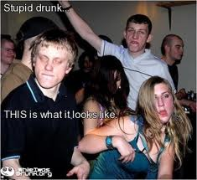
Teens Report Higher Frequency of Sex and “Sex for Fun.”
In Sweden, 55% of 17-year-olds reported having experienced vaginal intercourse and stated that, “Neither being in love, nor having a steady partner, was a prerequisite for having sex.”
(Adolescent Sexual Health in Sweden, Sex Transm Infect, 2002)
Notes:
Read

Slide 45
Recreational Sex and Sexually-Transmitted Diseases (STDs)
US Centers for Disease Control experts admit that STDs are out-of-control -- with more than 100 million people having a sexually transmitted disease at any given time;
20 million cases of STDs are reported each year, especially in those 15-25 years old.
Every 20 million cases cost the American health care system an additional $16 billion in direct medical costs.
Notes:
The financial and emotional cost of recreational sex with the explosion of STDs is “out of control”.

Slide 46
Should We Give up on Marriage and the Family?
Notes:
So with so much break down around the globe should we give up on the ideal purpose of marriage, family and human life? Should we, as the saying goes, “Throw the baby out with the bathwater? “

Slide 47
What Can We Do to Strengthen Marriage and the Family?
Clarify the purpose of marriage, family and life.
Promote a marriage- and family-oriented culture, media and social policies; respect for religious values; and religious communities that support and educate about marriage.
Replace sexualizing sex education with relationship and character education for youth, as much as possible taught by or including the parents.
Offer premarital education and marital education, mentoring for couples, parenting education, and support for single and divorced parents.
Improve our own relationships by being intentional, be a better spouse/parent/child, and focus on what is most valuable.
Notes:
So, what can you do to strengthen marriage and the family? These are some suggestions. Read. Ask: What are your recommendations? What specific tasks we can take on as Ambassadors of Peace to strengthen the family and build a culture that nurtures and teaches peace from inside the heart and mind of each of us?

Slide 48
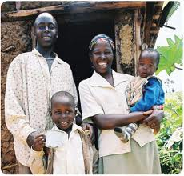
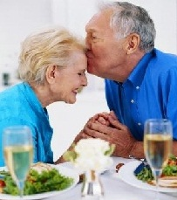
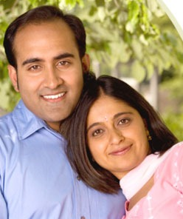
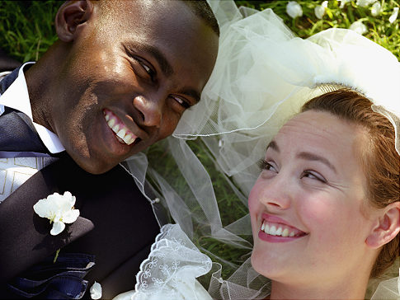
Notes:
Thank you!

