Slide 1
Universal Peace Federation
Marriage, My Spiritual Path
Tending to the soul of your marriage
UPF Marriage and Family Series

Slide 2
Tending to the Soul of your marriage
Most marriages do not need more excitement, activity, glitz but they yearn for depth
Notes:
Just staying together is not good enough. We can and must do better. Marriage is meant to be vibrant, and alive with personal growth and deepening of one’s connection, increasing appreciation for each other as you face life together.

Slide 3
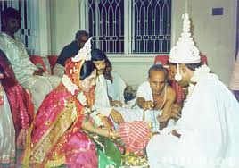
Marriage is a Spiritual Partnership
Research finds couples sharing faith & spiritual commitment to each other are more likely to be happy
Notes:
Shared meaning/purpose elevates relationships. No single factor does more to cultivate oneness and a meaningful sense of purpose in marriage than a shared commitment to spiritual discovery. Marriage when it is healthy has a mystical way of revealing God and promoting spiritual growth.

Slide 4
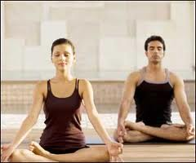
Marriage and Spiritual Practice Requires Self-discipline, Emotional Control , Overcoming Selfishness
Notes:
IN order to be a better partner we need to develop self-awareness, self-control, emotional intelligence, and overcome selfish tendencies. This does not mean we are doormat. We assert ourselves when needed but in a positive, responsible and constructive way – which again takes emotional intelligence and self-control.

Slide 5
Trying to change your partner is not Honoring
Notes:
Most people work hard in their relationships, trying to change their partner - which is the wrong work. In this your message to your partner is “You are unacceptable, my love is conditional of my terms, I no longer accept your faults that were always there, you have to change to my standards, I can’t accept that your opinions, expectations, weaknesses are there for valid reasons, but mine are valid, I am right you are wrong”. Is this the right attitude? Does this end up solving the problems and bringing you both closer? No
( On the otherhand, some just endure unhappy “faithfully’ and this is the wrong work too, or no work.)

Slide 6
This is about Me
You can’t change your partner. Your Focal Point is your own spiritual path not on your partner or your relationship, but your highest self
Notes:
The answers to your conflicts, longings, disappointments, are not out there in someone else…everything you need for peace and happiness is within you, & that is where your relationship work has to start. The only person you can change is yourself. .
We need to ask ourselves: If I am going to behave in accord with my highest spiritual self, what will I do right now? How can I be the most loving person in this moment and act from my core values?

Slide 7
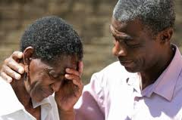
Relationships as Spiritual Practice
Spirituality is not more and more principles you learn; it is a quality you gradually achieve, the person you become, connecting to the deepest level of self by the actions that you choose to do.
Notes:
In relationships you are certain to feel isolated, revert to worst aspects of your personality, feel anger, fear, confusion… right then you have the opportunity to work on these spiritual challenges…watch for “spiritual experiments” you can do and better choices you can make that comes from a “bigger” self.

Slide 8
Verbal Communication: Often ineffective or worse
Most of our habits involve destructive communication, most of us lack skill
It is easier to get off center while
communicating verbally and to be
misinterpreted.
Motivation often is to change the
spouse, ineffective & disrespectful.
Notes:
Contrary to what you often hear, communication in a relationship is not the most important component. Communication does not always work: some are better at it than others, making it unfair. Or the purpose may be to change our spouse.
Good communication is important (there is another presentation on good communication!) but it will happen when our attitudes are focused on our personal, spiritual responsibility, and building connection. But even more effective than talking is choosing good actions.

Slide 9
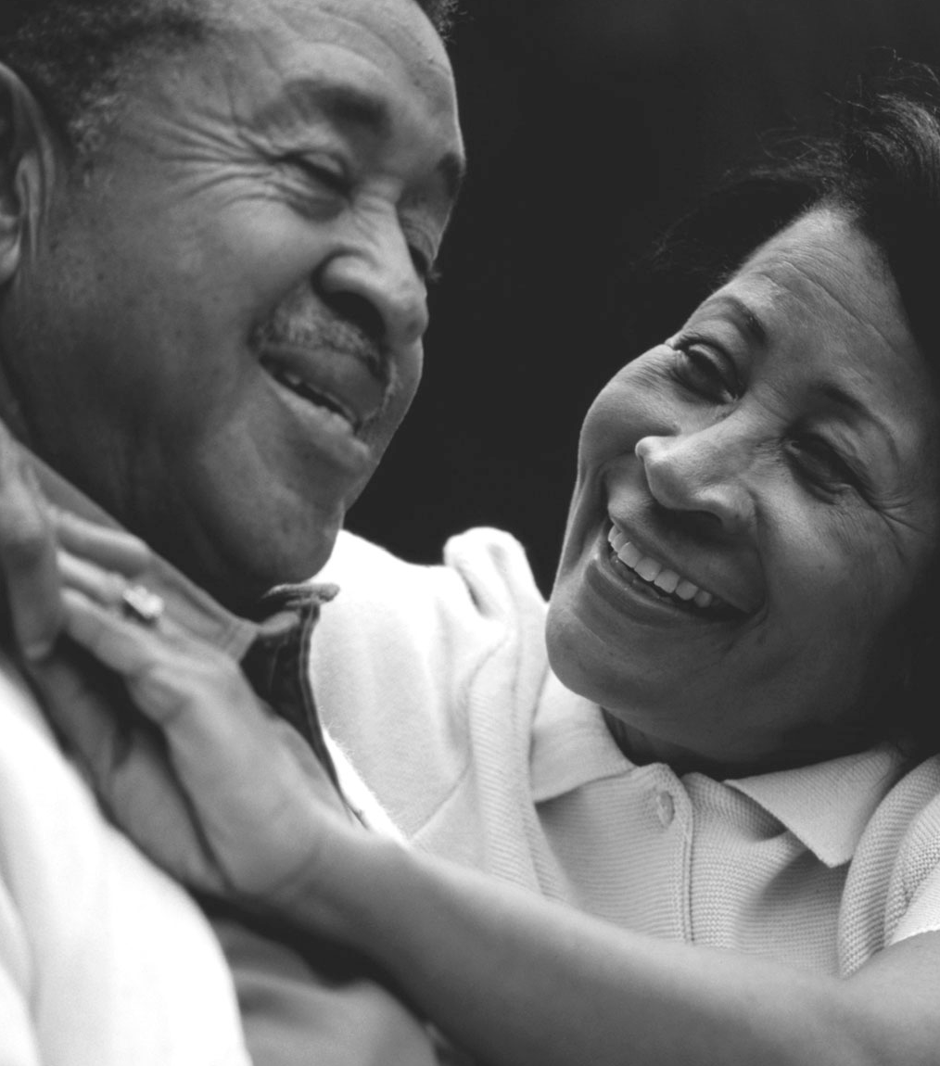
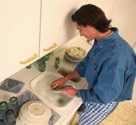
Loving Acts: Reliable Spiritual Practice
Loving Actions can make all the difference, and speak louder than words.
Notes:
There might not be time or availability, to talk everything through. You have time, though, to choose better behavior, even in just your change of tone or facial expression or touch. Give example: Angry at husband for coming home late, dinner you fixed is now cold, you felt angry/unimportant, but instead of greeting him in anger or coldness, you give sincere hug. After this choice of behavior how do you feel? And what part of you is manifest? How are you seeing the situation differently than when you were just angry? What response will you get now? And what would you have received if you went ahead and gave the angry sneer? (If we do this we will probably find out why he is late etc. And we can also request that he calls when late but you will do so in a way that he will accept.)

Slide 10
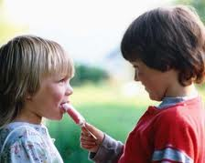
Loving Actions
Unilateral
Will
Experimental
Spiritual growth
Notes:
Motivated by the desire for spiritual growth, we often do that which we do not feel like doing, without being sure of the outcome, requiring self-discipline and will, our action often changes the way we feel.
Unilateral, we are acting out of our authentic self, core values, on our own, not dependent on the other.
Will, this is an act of will, often counter to our immediate feelings, but because it is a loving thing to do
Experimental , We have no guarantee or expectation that this will work or change our partner, we are trying something different out of good will
Spiritual growth, we value the act because we grow in doing it, actualize core beliefs and our better self
Give another example and then Ask for Examples from the group. When you do something for your spouse against your first negative reactions that is loving instead. How do you feel? Even if it is not recognized or change the situation? What changes in you?

Slide 11
The Power of One: Homework
One person can change the relationship
Choose a specific, concrete action or behavior that you could do, for a certain time period, with out telling your spouse, that would be loving and positive for your spouse.
Try the experiment for your spiritual growth and out of good will.
See if you change internally and if anything changes in the relationship.
Notes:
WE all know how to hit the “hot buttons” to irritate our spouse. Now we will practice how to hit the “love buttons” instead. Give this as homework. Then either individuals can write down or break into pairs – but NOT couples! – and have each person come up with their ideas, plan and then set a clear specific action goal (e.g. : Not - we will communicate better, but - I will turn off the tv and look at her face and paraphrase what she is saying, twice this week.) Not - we will be closer, but - I will appreciate three things he does every day for three days) Not - I wont yell at my kids but - I will find myself sitting down with my kids, using a calm voice, and listening to them while looking at their face, one time a day for a week.) If possible plan some follow up for reporting the results. You could discuss after they are finished writing their goals if they want to share , but not if the spouse will hear the “plan”.

Slide 12
Loving Actions
To live in accord with spiritual values is to live by choice and awareness rather than always to be in reaction to the people around you
Notes:
IT is best to see this as your spiritual exercise to improve yourself. It may not bring a result, it may back fire, that is ok. Even if spouse does not respond, you have still been loving. (God reaches out to us continually and so often we do not respond.)
Then set another goal to hit another love button and appreciate that you are changing for the better.

Slide 13
Deepening Connection
The more you are motivated by your most inner stirrings, the more you become your most authentic self,… the more you will be able to connect with your spouse at a deep level.
Notes:
Again this is about you. One person can change a relationship just by accepting one’s spiritual responsibility to learn how to love another imperfect human being. Your communication will change because you are speaking from a more vulnerable and genuine self.

Slide 14
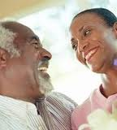
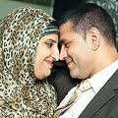
Loving: Our Spiritual Path
The teachers we need most are the people we’re living with now. Our spouses, parents, and children are the clearest masters we could hope for. Again and again they will show us the truth we don’t want to see, until we see it.
Notes:
Learning to love our spouse is one of the greatest of spiritual paths. The risk that you take are acts of faith and an expression of what God gives us. We as spiritual beings co-create our marriages with God’s presence. God wants so much to dwell in our marriages, for his is where His heart is most deeply expressed and He will be there to teach us.
(This could be the end or a final discussion. Give an example, from marriage or parenting. )
Recommend reading: Susan Page’s “When Talking is not Enough” or Michelle Weiner-Davis’s “Divorce Remedy” or any of her books and then Byron Katie’s “Loving What Is”.

Slide 15
Thank you

