Slide 1
Universal Peace Federation
The Benefits of Marriage
Why get married? Why stay married?
UPF Marriage and Family Series

Slide 2
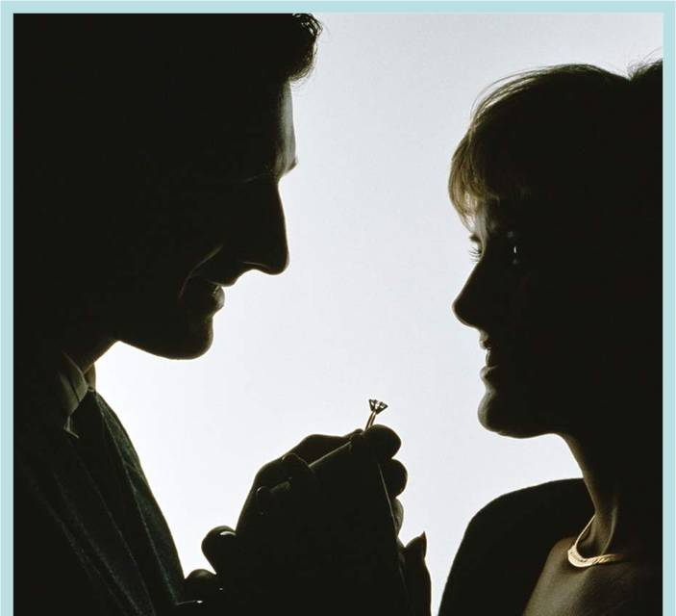
Why Get Married?
Notes:
Ask for responses from the audience.
Suggestion: Put up a big piece of paper and have someone write down the answers.
Why
Get married?

Slide 3
Why Get Married?
Because you think of it as a path to happiness ....
Because you found your soul mate and decided to spend your life together ...
Because of pressure by parents and society ...
Notes:
Mention some of the responses given by the audience.

Slide 4
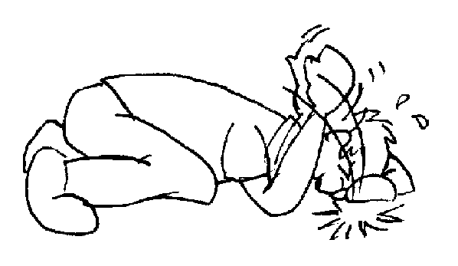
Did anyone say it would be easy?
Notes:
No need to comment.

Slide 5
Why Stay Together?
Notes:
Ask for responses from the audience.
Suggestion: Put up a big piece of paper and have someone write down the answers.

Slide 6
Mutual Commitment on a Shared Journey
The family is a “school of love” for all its members, and we are life-long students.
Mutual commitment maintains our bond during difficult times – allowing us to:
Grow in love.
Enrich the lives of each other and our children.
Enjoy life-long benefits.
Notes:
Mention some of the responses given by the audience that relate to the above points.

Slide 7
Assignments in the School of Love
Provide for health and material well-being.
Care for emotional well-being.
Model loving relationships.
Protect from abuse.
Teach children social skills.
Discipline the children to promote their moral development.
Educate children to be contributing members of society.
♥
♥
♥
♥
♥
♥
♥
Notes:
Marriage is about bringing men and women together so children can have the benefit of being raised and nurtured by both their mother and father.
Marriage – The commitment and sexual exclusivity of a man and woman allows them to INVEST for their children’s benefit:
- Concern for their health and material well-being
- Concern for their emotional well-being
- Concern for their educational attainment
- Concern for their disciplining and moral development – so they act in ways that benefit the social good
- Protecting the children from abuse in any form
- Modeling of a couple relationship so the children have some successful strategies when they build their families
The family is a school of love – where children learn important social skills such as forgiveness, tolerance, and altruism.
If parents do their job well, the next generation does slightly better in some or all of these areas – lineage improvement occurs.

Slide 8
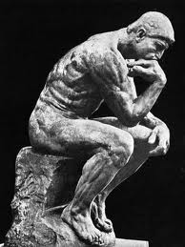
To Think About
Do we ever graduate from the school of love?
Notes:
Invite comments or let people think about the question on their own.

Slide 9
Research Results: children do best when they are raised by their two, married, biological parents.
They have better relationships with their parents.
They are more likely to
Thrive
Have better health
Be happier
They are less likely to:
Be abused
Misuse alcohol or drugs
Divorce or become unwed parents
Notes:
Worldwide research over the past 60 years is clear: The best outcomes occur when children are raised by their two, married, biological parents – by the people who brought them into the world. on average, they have far better outcomes in every area – when compared to children raised in –
Single-parent homes, never married
Single-parent homes, divorced
Cohabiting couples with children
Step-parenting homes
Children raised by same-sex couples
All other family constellations
From 2011 summary of research studies “Why Marriage Matters,” by Bradford Wilcox:
“Family instability is generally bad for children. In recent years, family scholars have turned their attention to the impact that transitions into and out of marriage, cohabitation, and single parenthood have upon children. This report shows that such transitions, especially multiple transitions, are linked to higher reports of school failure, behavioral problems, drug use, and loneliness, among other outcomes. So, it is not just family structure and family process that matter for children; family stability matters as well. And the research indicates that children who are born to married parents are the least likely to be exposed to family instability, and to the risks instability poses to the emotional, social, and educational welfare of children.”

Slide 10
Research Results Marriage Benefits Husband and Wife.
Greater security and stability in the relationship
Happier
Differences can complement each other
Physically and mentally healthier
Wealthier
Less likely to commit crimes or be victims of crimes
Better sex
Sounds pretty good, right?
Notes:
With the martial commitment and fidelity in place, married partners as a pair, on average, do better on almost every social scale.
Married partners with children – working together through life for a healthy, meaningful purpose - are also, on average:
Wealthier (married men earn between 10% to 40% more than single men; they save more than single men; if you have others to take care of it motivates you to do whatever it takes to support them.)
Healthier (less likely to smoke, drink heavily, or be physically inactive; more likely to eat better and have more resources for a healthier life)
Better sex (because of trust, mutual understanding)
Happier (being committed to something bigger than themselves contributes to happiness. 40% of married people said they were generally happy with their life, while only 25% of single people said they were.)
Live longer (when compared to cohabiting couples, single parents and divorced people)

Slide 11
Research Results Marriage Benefits the Husband.
Motivates him to focus on the benefit of others.
Adds an average of 10 years to his lifespan.
Channels his natural sex drive.
Notes:
Husbands also, on average, do better on every social scale:
- Marriage allows men to channel their natural sex drive into something that has positive outcomes for society.
- It allows men to enter into community building - helping them move from independent thinking to thinking about how they can use their life to benefit others – and to find meaning through focusing on homebuilding and child rearing.
With purpose and meaning, research shows they drink less, are more stable in their jobs, are less likely to commit crimes or violence, are less likely to take drugs, are less likely to visit prostitutes or sleep around, etc.
They also live an average of 10 years longer.
“Because of divorce, young men in England and Germany have become much more prone to criminality, drug abuse, and sub-criminal disorder.”
Norman Dennis, University of Newcastle, UK
“When men and boys embrace the norm of stable married life, violence and disorder decline, and peace ensues as men become stakeholders in community life.”
Sociologist David Courtwright

Slide 12
Research Results: Marriage Benefits the wife
Less at risk of physical or sexual abuse
Less likely to suffer depression
Less inclined to substance abuse
Less likely to indulge in risky behavior to obtain sex
Notes:
Wives also, on average, do better on almost every social scale.
Women who have a husband who is interested in her long-term health and well-being, on average, are less likely to:
- suffer physical harm or sexual abuse
- suffer from depression
- over-drink or abuse drugs
- Indulge in risky behaviors to get love.

Slide 13
Discussion
Divide into 5 groups to look at the research findings and discuss how they compare to the situation in your community or nation:
Family
Economics
Physical health and longevity
Mental health and emotional well-being
Crime and domestic violence
Afterwards, invite someone from each group to give a summary of their discussion.
Notes:
These were broad-based research results. Among our group today are many knowledgeable people with broad experience. Let’s compare these results with what we know about our community and nation. Do they apply to us?
Make copies of the one-page summary of research and distribute them.
Divide participants into five groups and ask each group to discuss one of the areas for 10 minutes or so.
Afterwards ask a representative of each group to report to the whole.

Slide 14
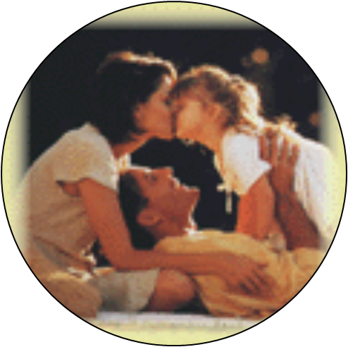
In Conclusion
The family structure with the most benefit for both the couple and their children:
married husband and wife raising their children
Notes:
Mention comments from group reports that related to this conclusion.

Slide 15
Expanding the Circle of Life
As caretakers
As creators
Notes:
We are tiny part of the history of humankind.
In some ways we are just caretakers – making sure we keep the best of what past generations developed, and
In some ways we are creators – we have the potential to add own positive contribution so future generations benefit.
If our overall contribution is positive, then the future of humanity is secure. If our overall contribution is negative, humanity takes a step backwards and future generations suffer.

Slide 16
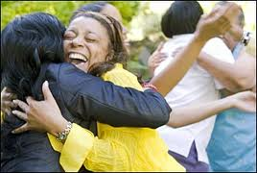
To Think About
Can the next generation be a little bit
More loving?
More intelligent?
Better at building intimate relationships?
Better at weathering the storms of life?
Empowered to make the world a better place?
... because of my contribution to my family and society?
Notes:
Our role in human development: “Can the next generation be slightly more loving, slightly more intelligent, slightly better at building intimate relationships, and slightly less traumatized - because of my input into my family and society?”

Slide 17
To Think About
How can the extended family, the community, and public policy support thriving marriages and families?
Notes:
Can society offer couples better support during the typical bumps of married life so they can continue the journey together and raise their children well?
If societies can get better at both of these – helping married couples over the bumps, and improving the standard of love that partners offer each other – then ever more couples will find themselves being rewarded with the blessings of nature’s sustainability and well-being.

