Slide 1
Universal Peace Federation
Family as the School of Love and Peace
The Family as a Sacred Institution
UPF Marriage and Family Series

Slide 2
Family as the School of
Love and Peace
Notes:
Welcome to our presentation on the significance of marriage, family and the blessing.
The primary ministry of Reverend Sun Myung Moon and Dr. Hak Ja Han Moon is the blessing of marriage. We believe that God’s work in the world, through all religions, is culminating today in the perfection of marriage. In addition, secular scholars are realizing that marriage and family life are indeed essential to human happiness, peace and prosperity.
Let us explore some of Reverend Moon’s teachings and activities in this vital area.

Slide 3
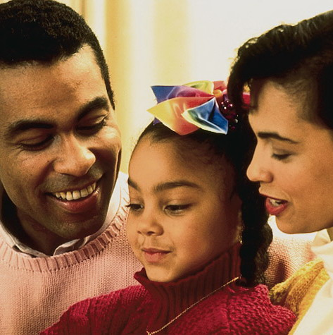
The First Human Institution
The family is the most
important human
institution. Without it
we would not exist.
Through it we transmit
language, culture,
ethics, core values -
even religion.
Notes:
2011/10/3
3

Slide 4
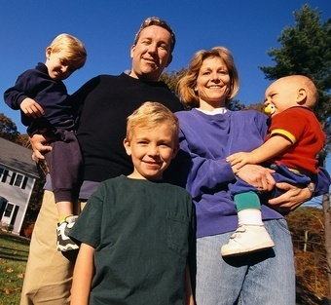
Love Makes the Family.
The quality of character,
and the quality of the
love of the man and the
woman, as husband and
wife and as father and
mother, makes all the
difference.
Notes:
2011/10/3
4

Slide 5
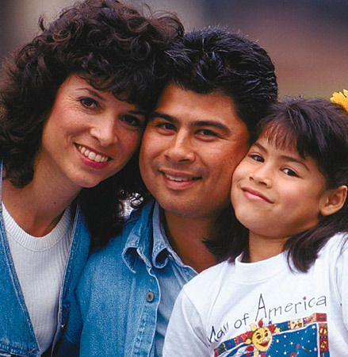
The Family Is Sacred.
The family---marriage and parenthood---
is regarded as sacred by the world’s religions.
Notes:
2011/10/3
5

Slide 6
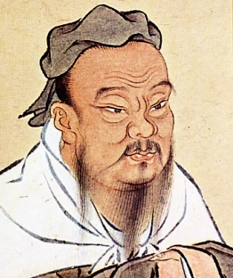
Family Relations Are Essential.
There are five relations of utmost importance under Heaven…between prince and minister; between father and son; between husband and wife; between elder and younger brothers; and between friends.
Confucianism, Doctrine of the Mean
Notes:
2011/10/3
6

Slide 7
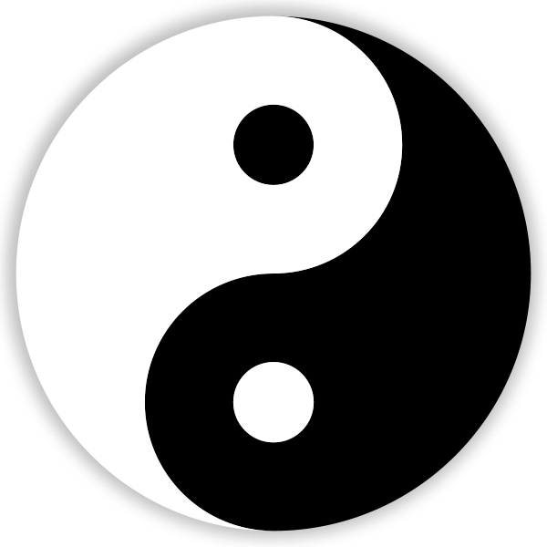
The Family Influences the Whole.
It is by the proper regulation of each family that the whole world is stabilized.
I Ching 37
Notes:
2011/10/3
7

Slide 8
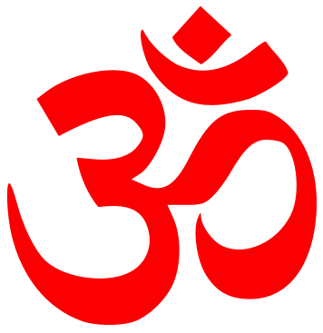
Family As a Spiritual Foundation
When the family declines, ancient traditions are destroyed. With them are lost the spiritual foundation for life, and the family loses its sense of unity.
Hinduism, Bhagavad-Gita 1.40
Notes:
2011/10/3
8

Slide 9
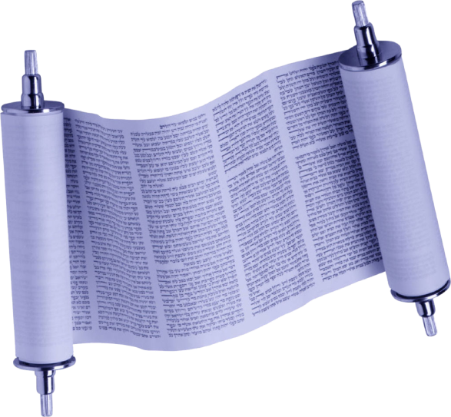
The Family Honors God.
When a man honors his father and mother, God says, “I regard it as though I had dwelt among them and they had honored me.”
Judaism, Talmud
Notes:
2011/10/3
9

Slide 10
Family Symbolizes Heaven and Earth.
Representing heaven and earth I have created husband and wife. This is the beginning of the world.
Tenrikyo, Mikagura-uta
Notes:
2011/10/3
10

Slide 11
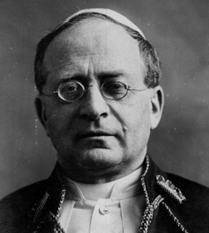
A Partnership between God and Man
The sacred partnership of true marriage is constituted both by the will of God and the will of man.
Christianity
Pope Pius XI, Casti Connubi
Notes:
2011/10/3
11

Slide 12
Types of Love in the Family
The family has the potential to manifest, most fully, God’s ideal of true love.
God
Children’s love
Brotherly and sisterly love
Marital love
Parental love
Husband
Wife
Child
Child

Slide 13
The Significance of Marriage
A partnership of man and woman
A sacred, exclusive and eternal commitment
Forms the most fulfilling, secure and constructive base for:
sexual/conjugal love
creation of new life
establishment of lineage
raising/educating children

Slide 14
Love, Life and Lineage
Marriage joins the life of one woman and the life of one man. In time, through children, it joins the lineage of the man and the lineage of the woman. It thus begins a history, a nation, the world and the Kingdom of Heaven on Earth.
Sun Myung Moon

Slide 15
The Significance of Sexual Love
Sexual organs of husband and wife are complementary and fulfill dual purposes:
Create joy, closeness, oneness
Give rise to new life: children
Notes:
Most essential, then love, what kind, if mature unselfish, centered on God, representing yingyang of the universe, embodies God’s highest expression. Bonding of hormones, glue, single parents great, but societies that best raise their children, 2 parents, will thrive, produce children of secure, loved and loving, responsible, conscientious

Slide 16
Marital Love Is Exclusive
No adultery
Adultery/infidelity undermines trust and violates the heart of one’s spouse.
Pre-marital sex and multiple sexual partners, including pornographic sex, create self-centered habits and weaken the bonds of love in marriage.
Our sexual organ is not to be used freely, but only in exclusive partnership with our spouse.
Notes:
Most essential, then love, what kind, if mature unselfish, centered on God, representing yingyang of the universe, embodies God’s highest expression. Bonding of hormones, glue, single parents great, but societies that best raise their children, 2 parents, will thrive, produce children of secure, loved and loving, responsible, conscientious

Slide 17
Our Spouse and Sexual Love
If all men and women admit that their sexual organ belongs to their spouse, we all will bow our heads and become humble when we receive our spouse's love. Love comes to you only from your partner.
Sun Myung Moon,
“In Search of the Origin of the Universe”

Slide 18
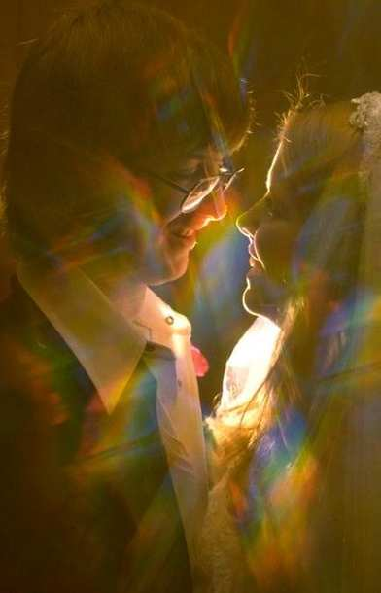
Importance of Sexual Abstinence
Before Marriage
Should focus on developing character, talents, capacities, and virtues, to become a good man, husband and father; or a good woman, wife and mother.
Premarital sex is detrimental to our character development and to our capacity to establish a good marriage and family.
Notes:
Brides may expect a diamond engagement ring before marriage. But what is the most precious gift before marriage? Substantial pure love. What is the value of a diamond ring if the partners have already experienced physical relationships with other people? The pure love substance is absolutely the most precious. God's deep desire is to see eternal love between one husband and one wife.

Slide 19
Sexual Disorder and Family Breakdown
Sexual promiscuity, infidelity, pornography lead to sexually transmitted disease, divorce, and family breakdown
Family breakdown undermines social stability, good citizenship, educational development, and contributes to crime, youth alienation and suicide.
To build a world of lasting peace, we need to restore true love, true parenthood and true family

Slide 20
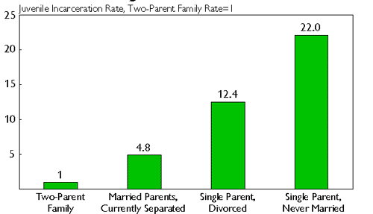
Sexual Disorder and Family Breakdown
Source: Heritage Foundation

Slide 21
The Blessing Movement: Building One Family Under God, One Family at a Time
Affirms the sacred and social value of marriage and family
A public commitment to one universal human family bound together in solidarity and mutual respect, beyond the barriers of race, religion, nationality and culture
Each of us has a “family-building” responsibility----as a parent, a spouse, a sibling, a child---that contributes to the broader task of peacebuilding.
Notes:
Father and Mother Moon have conducted a number of such marriage blessings have been conducted in recent years, including couples from all races, religions and nations, both previously married couples and newly matched couples.
These couples are affirming this teaching and joining together to begin creating heavenly families. They are affirming a common value that unites races, religions and nations, to build not only true families but also world peace.

Slide 22
36 Couples Marriage Blessing Ceremony

Slide 23
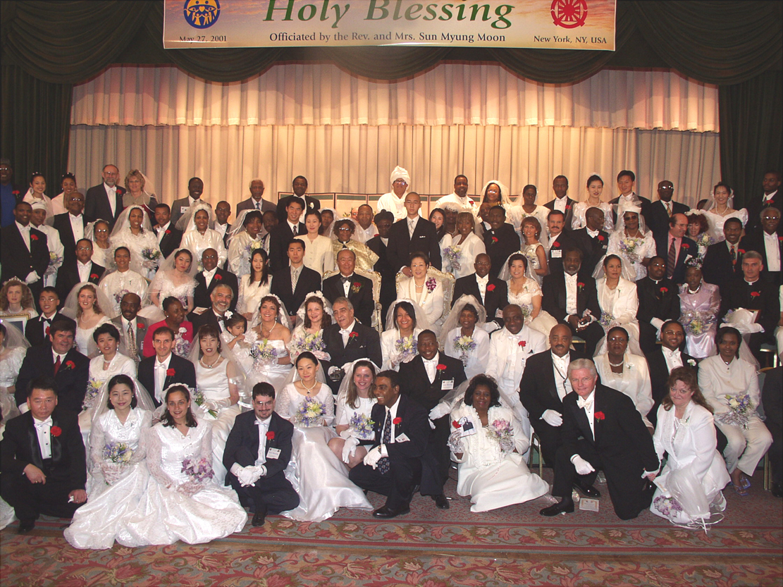
Marriage Blessing of Religious Leaders

Slide 24
The Blessing Pledge
To be faithful in marriage: no adultery
To raise children and grandchildren to be pure in preparation for marriage
To live for the sake of others as a married couple and as a family
To encourage people of all races, religions, nationalities and cultures to live as one family under God.
Notes:
Father and Mother Moon have conducted a number of such marriage blessings have been conducted in recent years, including couples from all races, religions and nations, both previously married couples and newly matched couples.
These couples are affirming this teaching and joining together to begin creating heavenly families. They are affirming a common value that unites races, religions and nations, to build not only true families but also world peace.

Slide 25
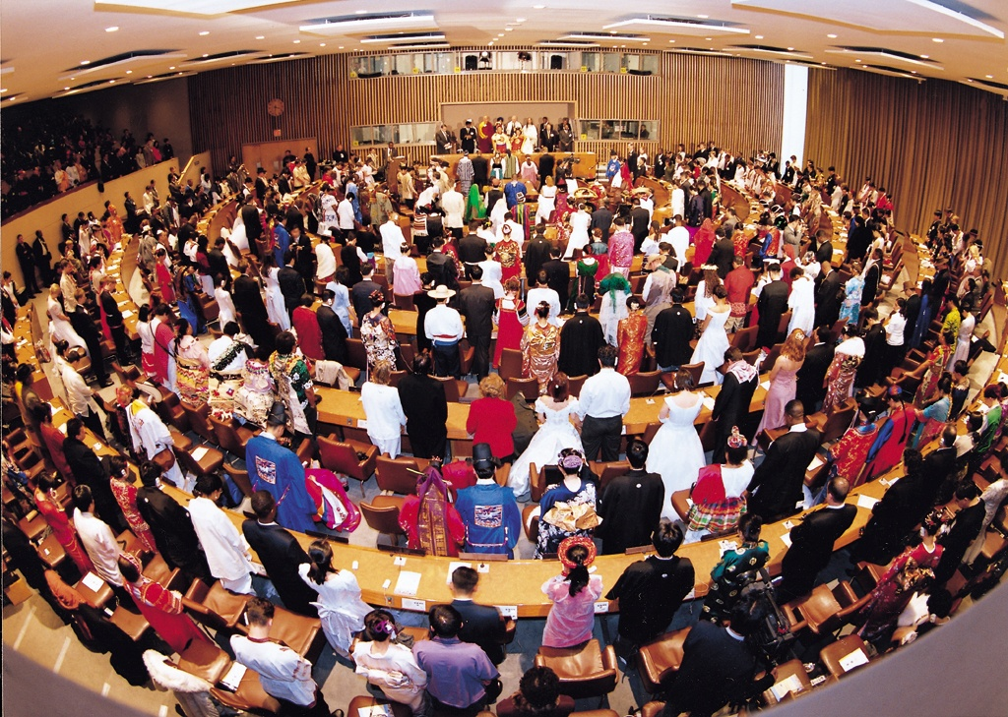
World Peace Blessing Ceremony held at the United Nations

